Slide 1
Lecture 11 Relational Database Design MVD
Good Design
Atomic
Dependencies
BCNF
3rdNF
MVDs
Design Process
United International College

Slide 2
Outline
Good Design
Atomic
Dependencies
BCNF
3rdNF
MVDs
Design Process
Features of Good Relational Design
Atomic Domains and First Normal Form
Functional Dependency Theory
BCNF
3rd Normal Form
Multivalued Dependencies and Decomposition
Database-Design Process

Slide 3
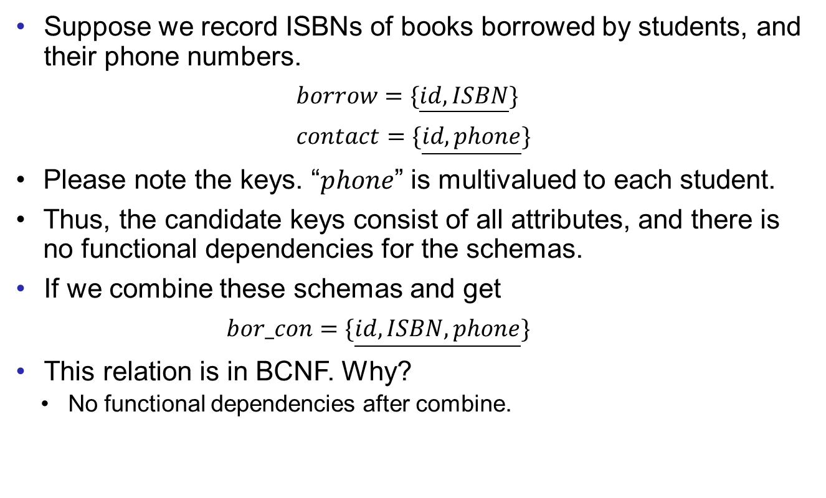
Multivalued Dependencies
Good Design
Atomic
Dependencies
BCNF
3rdNF
MVDs
Design Process
Suppose we record ISBNs of books borrowed by students, and their phone numbers.
$borrow=\{\underline{id,ISBN}\}$
$contact=\{\underline{id,phone}\}$
Please note the keys. “$phone$” is multivalued to each student.
Thus, the candidate keys consist of all attributes, and there is no functional dependencies for the schemas.
If we combine these schemas and get
$bor_con=\{\underline{id,ISBN,phone}\}$
This relation is in BCNF. Why?
No functional dependencies after combine.

Slide 4
Multivalued Dependencies
Good Design
Atomic
Dependencies
BCNF
3rdNF
MVDs
Design Process
Example data:
After combine, we see redundancies.
Thus, we need another normal form to handle the multivalued cases.
ID | ISBN
99999 | 978-0465026562
99999 | 978-1439851296
ID | phone_number
99999 | 512-555-1234
99999 | 512-555-4321
ID | ISBN | phone_number
99999 | 978-0465026562 | 512-555-1234
99999 | 978-0465026562 | 512-555-4321
99999 | 978-1439851296 | 512-555-4321
99999 | 978-1439851296 | 512-555-1234

Slide 5
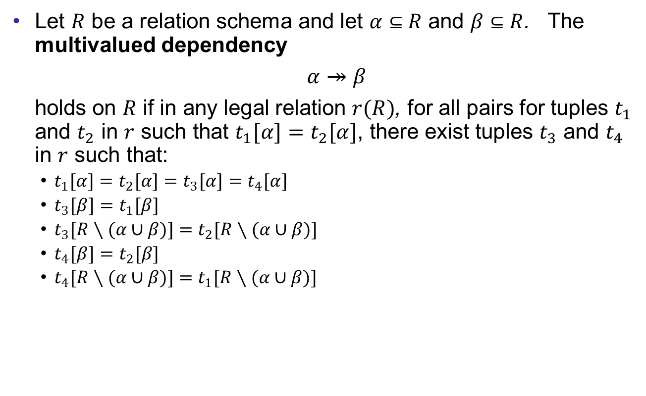
Multivalued Dependencies
Good Design
Atomic
Dependencies
BCNF
3rdNF
MVDs
Design Process
Let $R$ be a relation schema and let $α⊆R$ and $β⊆R$. The multivalued dependency
$α↠β$
holds on $R$ if in any legal relation $r(R)$, for all pairs for tuples $t_{1}$ and $t_{2}$ in $r$ such that $t_{1}[α]=t_{2}[α]$, there exist tuples $t_{3}$ and $t_{4}$ in $r$ such that:
$t_{1}[α]=t_{2}[α]=t_{3}[α]=t_{4}[α]$
$t_{3}[β]=t_{1}[β]$
$t_{3}[R∖(α∪β)]=t_{2}[R∖(α∪β)]$
$t_{4}[β]=t_{2}[β]$
$t_{4}[R∖(α∪β)]=t_{1}[R∖(α∪β)]$

Slide 6
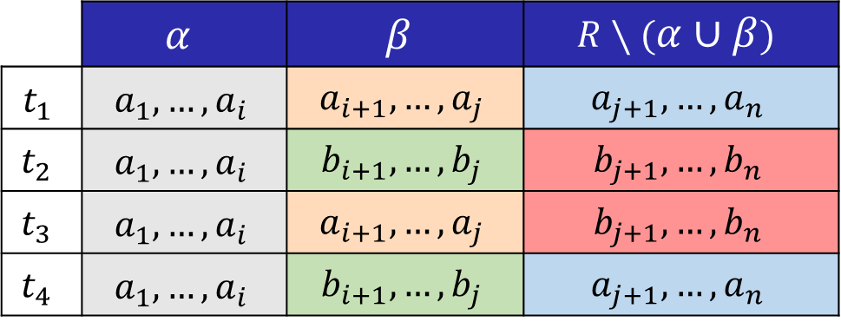

MVD
Good Design
Atomic
Dependencies
BCNF
3rdNF
MVDs
Design Process
A tabular representation of $α↠β$
 | $$α$$ | $$β$$ | $$R∖(α∪β)$$
$$t_{1}$$ | $$a_{1},…,a_{i}$$ | $$a_{i+1},…,a_{j}$$ | $$a_{j+1},…,a_{n}$$
$$t_{2}$$ | $$a_{1},…,a_{i}$$ | $$b_{i+1},…,b_{j}$$ | $$b_{j+1},…,b_{n}$$
$$t_{3}$$ | $$a_{1},…,a_{i}$$ | $$a_{i+1},…,a_{j}$$ | $$b_{j+1},…,b_{n}$$
$$t_{4}$$ | $$a_{1},…,a_{i}$$ | $$b_{i+1},…,b_{j}$$ | $$a_{j+1},…,a_{n}$$

Slide 7
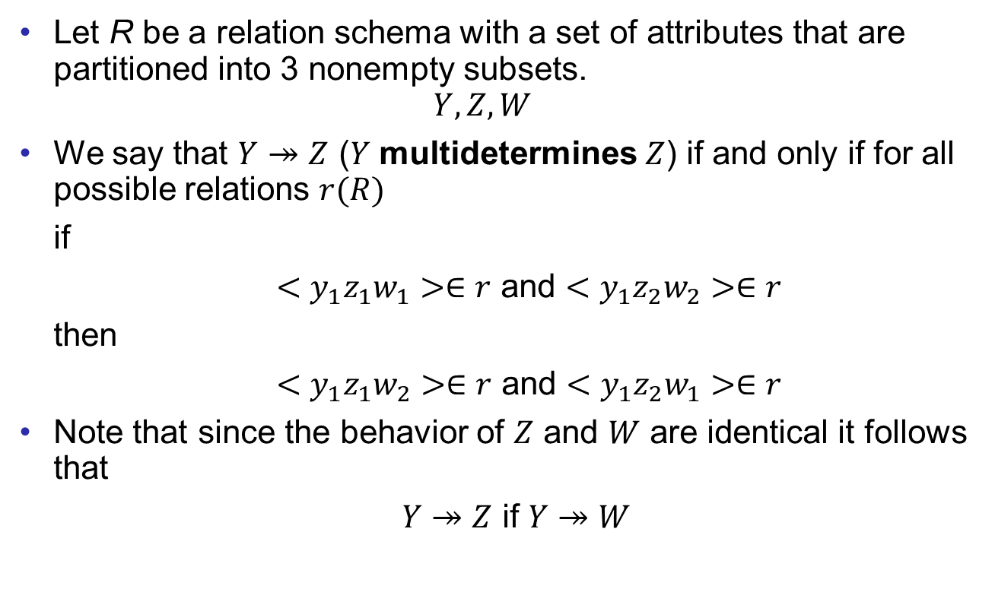
Example
Good Design
Atomic
Dependencies
BCNF
3rdNF
MVDs
Design Process
Let R be a relation schema with a set of attributes that are partitioned into 3 nonempty subsets.
$$Y,Z,W$$
We say that $Y↠Z$ ($Y$ multidetermines $Z$) if and only if for all possible relations $r(R)$
if
$<y_{1}z_{1}w_{1}>∈r$ and $<y_{1}z_{2}w_{2}>∈r$
then
$<y_{1}z_{1}w_{2}>∈r$ and $<y_{1}z_{2}w_{1}>∈r$
Note that since the behavior of $Z$ and $W$ are identical it follows that
$Y↠Z$ if $Y↠W$

Slide 8
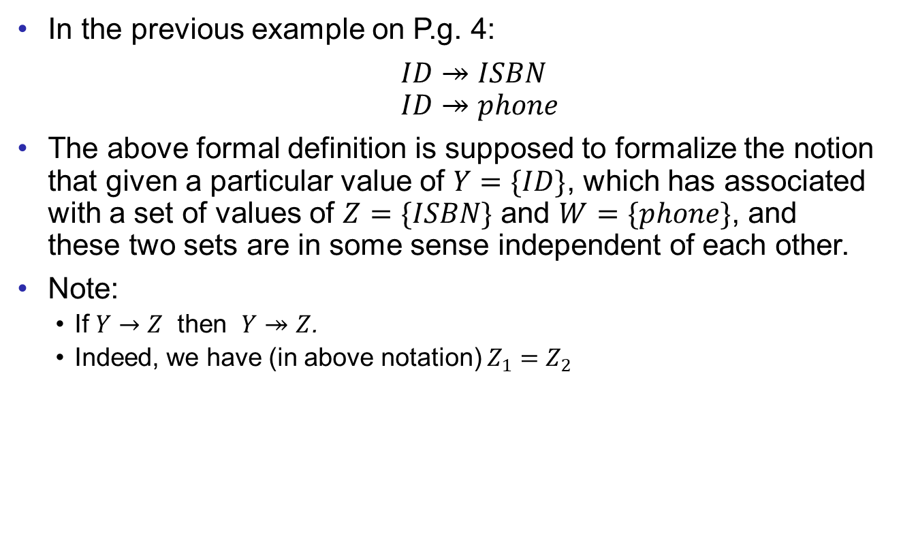
Example
Good Design
Atomic
Dependencies
BCNF
3rdNF
MVDs
Design Process
In the previous example on P.g. 4:
$ID↠ISBN$ $ID↠phone$
The above formal definition is supposed to formalize the notion that given a particular value of $Y=\{ID\}$, which has associated with a set of values of $Z=\{ISBN\}$ and $W=\{phone\}$, and these two sets are in some sense independent of each other.
Note:
If $Y→Z$ then $Y↠Z$.
Indeed, we have (in above notation) $Z_{1}=Z_{2}$

Slide 9
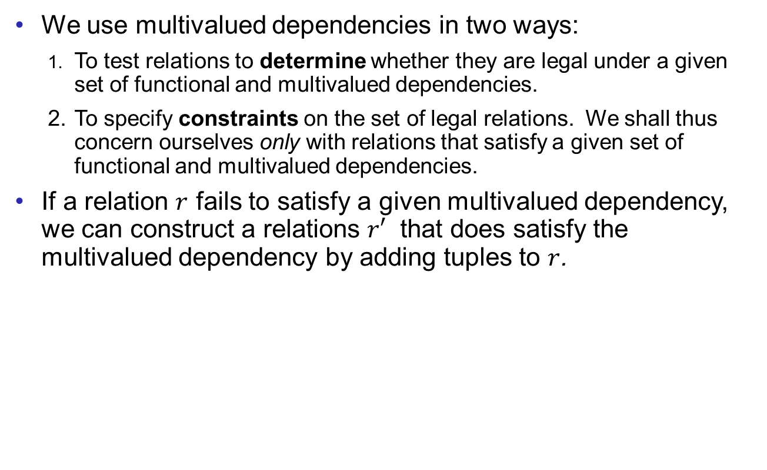
Use of Multivalued Dependencies
Good Design
Atomic
Dependencies
BCNF
3rdNF
MVDs
Design Process
We use multivalued dependencies in two ways:
1. To test relations to determine whether they are legal under a given set of functional and multivalued dependencies.
2. To specify constraints on the set of legal relations. We shall thus concern ourselves only with relations that satisfy a given set of functional and multivalued dependencies.
If a relation $r$ fails to satisfy a given multivalued dependency, we can construct a relations $r′$ that does satisfy the multivalued dependency by adding tuples to $r$.

Slide 10
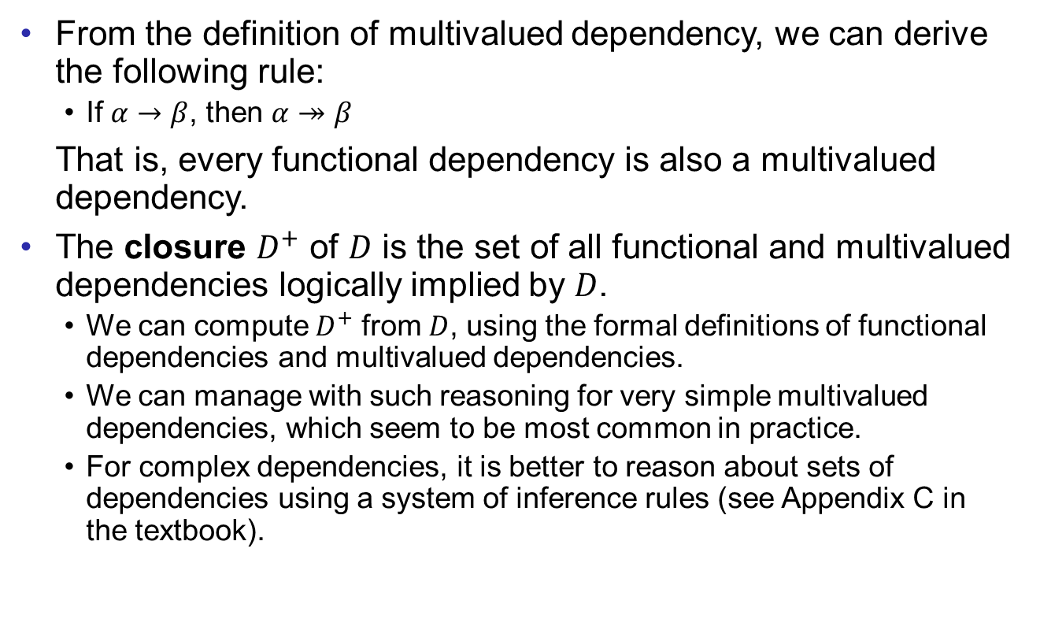
Theory of MVDs
Good Design
Atomic
Dependencies
BCNF
3rdNF
MVDs
Design Process
From the definition of multivalued dependency, we can derive the following rule:
If $α→β$, then $α↠β$
That is, every functional dependency is also a multivalued dependency.
The closure $D^{+}$ of $D$ is the set of all functional and multivalued dependencies logically implied by $D$.
We can compute $D^{+}$ from $D$, using the formal definitions of functional dependencies and multivalued dependencies.
We can manage with such reasoning for very simple multivalued dependencies, which seem to be most common in practice.
For complex dependencies, it is better to reason about sets of dependencies using a system of inference rules (see Appendix C in the textbook).

Slide 11
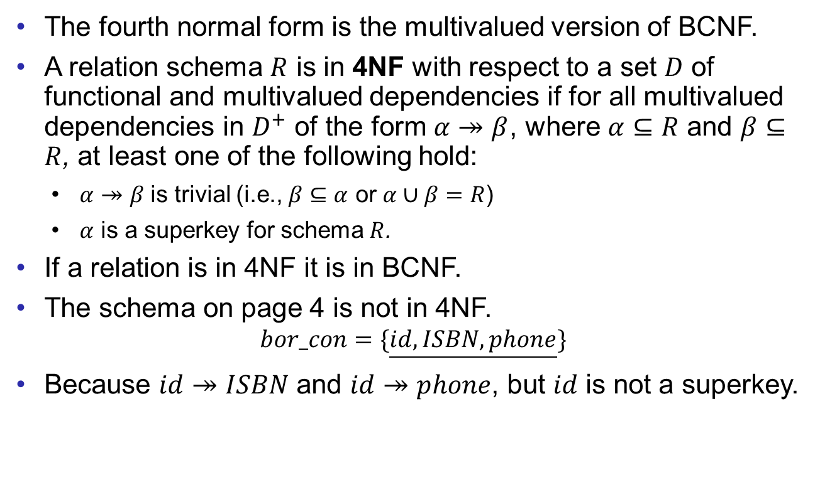
Fourth Normal Form
Good Design
Atomic
Dependencies
BCNF
3rdNF
MVDs
Design Process
The fourth normal form is the multivalued version of BCNF.
A relation schema $R$ is in 4NF with respect to a set $D$ of functional and multivalued dependencies if for all multivalued dependencies in $D^{+}$ of the form $α↠β$, where $α⊆R$ and $β⊆R$, at least one of the following hold:
$α↠β$ is trivial (i.e., $β⊆α$ or $α∪β=R$)
$α$ is a superkey for schema $R$.
If a relation is in 4NF it is in BCNF.
The schema on page 4 is not in 4NF.
$$bor_con=\{\underline{id,ISBN,phone}\}$$
Because $id↠ISBN$ and $id↠phone$, but $id$ is not a superkey.

Slide 12

Restriction of Multivalued Dependencies
Good Design
Atomic
Dependencies
BCNF
3rdNF
MVDs
Design Process
The restriction of $D$ to $R_{i}$ is the set $D_{i}$ consisting of
all functional dependencies in $D^{+}$ that include only attributes of $R_{i}$ and
all multivalued dependencies of the form
$$α↠(β∩R_{i})$$
where $α⊆R_{i}$ and $α↠β$ is in $D^{+}$.

Slide 13
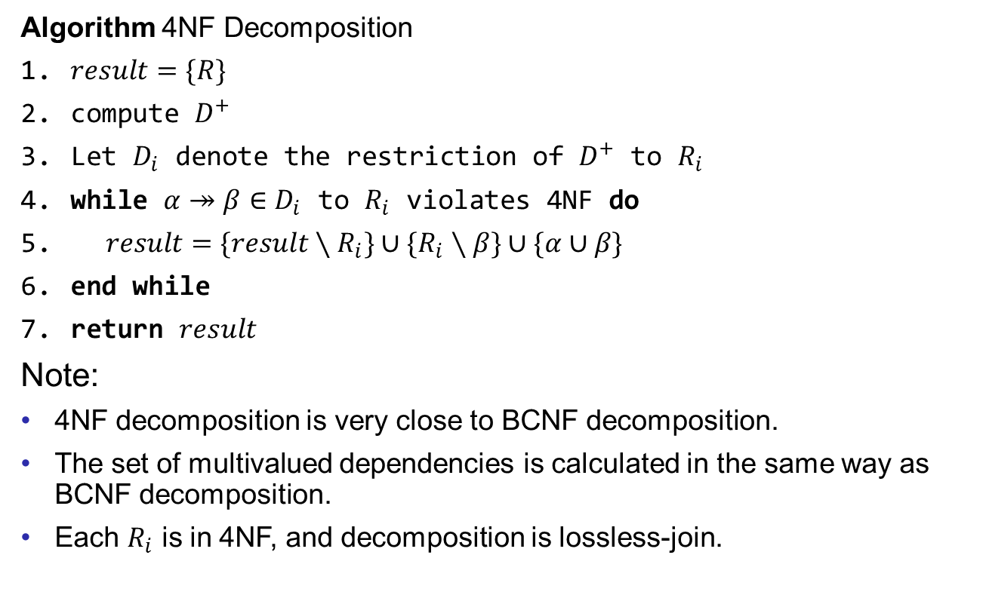
4NF Decomposition Algorithm
Good Design
Atomic
Dependencies
BCNF
3rdNF
MVDs
Design Process
Algorithm 4NF Decomposition
$result=\{R\}$
compute $D^{+}$
Let $D_{i}$ denote the restriction of $D^{+}$ to $R_{i}$
while $α↠β∈D_{i}$ to $R_{i}$ violates 4NF do
$result=\{result∖R_{i}\}∪\{R_{i}∖β\}∪\{α∪β\}$
end while
return $result$
Note:
4NF decomposition is very close to BCNF decomposition.
The set of multivalued dependencies is calculated in the same way as BCNF decomposition.
Each $R_{i}$ is in 4NF, and decomposition is lossless-join.

Slide 14
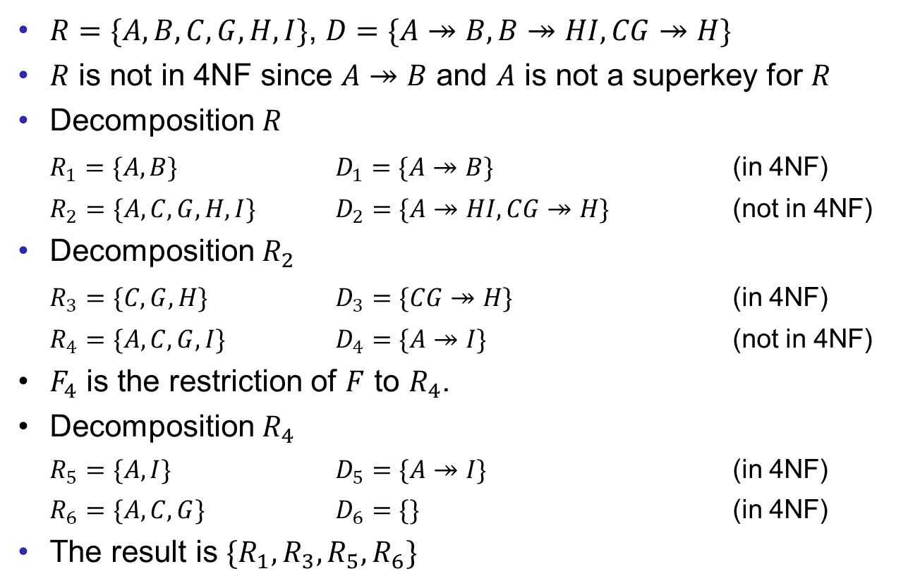
Example
Good Design
Atomic
Dependencies
BCNF
3rdNF
MVDs
Design Process
$R=\{A,B,C,G,H,I\}$, $D=\{A↠B,B↠HI,CG↠H\}$
$R$ is not in 4NF since $A↠B$ and $A$ is not a superkey for $R$
Decomposition $R$
$R_{1}=\{A,B\}$ $D_{1}=\{A↠B\}$ (in 4NF)
$R_{2}=\{A,C,G,H,I\}$ $D_{2}=\{A↠HI,CG↠H\}$ (not in 4NF)
Decomposition $R_{2}$
$R_{3}=\{C,G,H\}$ $D_{3}=\{CG↠H\}$ (in 4NF)
$R_{4}=\{A,C,G,I\}$ $D_{4}=\{A↠I\}$ (not in 4NF)
$F_{4}$ is the restriction of $F$ to $R_{4}$.
Decomposition $R_{4}$
$R_{5}=\{A,I\}$ $D_{5}=\{A↠I\}$ (in 4NF)
$R_{6}=\{A,C,G\}$ $D_{6}=\{\}$ (in 4NF)
The result is $\{R_{1},R_{3},R_{5},R_{6}\}$

Slide 15
Further Normal Forms
Good Design
Atomic
Dependencies
BCNF
3rdNF
MVDs
Design Process
Join dependencies generalize multivalued dependencies.
It leads to project-join normal form (PJNF) (also called fifth normal form).
A class of even more general constraints, leads to a normal form called domain-key normal form.
These generalized constraints are hard to reason with, and no set of sound and complete set of inference rules.
Hence, those normal forms are rarely used.

Slide 16
Outline
Good Design
Atomic
Dependencies
BCNF
3rdNF
MVDs
Design Process
Features of Good Relational Design
Atomic Domains and First Normal Form
Functional Dependency Theory
BCNF
3rd Normal Form
Multivalued Dependencies and Decomposition
Database-Design Process

Slide 17
Design Goals
Good Design
Atomic
Dependencies
BCNF
3rdNF
MVDs
Design Process
Goal for a relational database design is:
BCNF
lossless join, and
dependency preservation.
If we cannot achieve this, we accept one of
lack of dependency preservation or
redundancy due to use of 3NF
Interestingly, SQL does not provide a direct way of specifying functional dependencies other than superkeys.
We can specify FDs using assertions, but they are expensive to test.

Slide 18

Overall Database Design Process
Good Design
Atomic
Dependencies
BCNF
3rdNF
MVDs
Design Process
For schema $R$
$R$ could have been generated when converting E-R diagram to a set of tables.
$R$ could have been a single relation containing all attributes that are of interest (called universal relation).
Normalization breaks $R$ into smaller relations.
$R$ could have been the result of some ad-hoc design of relations, which we then test/convert to normal form.

Slide 19
ER Model and Normalization
Good Design
Atomic
Dependencies
BCNF
3rdNF
MVDs
Design Process
When an E-R diagram is carefully designed, identifying all entities correctly, the tables generated from the E-R diagram should not need further normalization.
However, in a real (imperfect) design, there can be functional dependencies from non-key attributes of an entity to other attributes of the entity.
Example: an employee entity with attributes
{department_number , department_address}
and a functional dependency set
{department_number → department_address}
A good design would have made department an entity.
Functional dependencies from non-key attributes of a relationship set possible, but rare - most relationships are binary.

Slide 20
End of Lecture 12
Good Design
Atomic
Dependencies
BCNF
3rdNF
MVDs
Design Process

